Slide 1
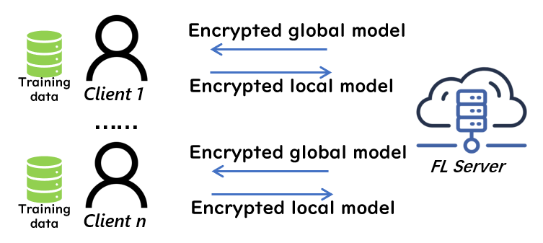
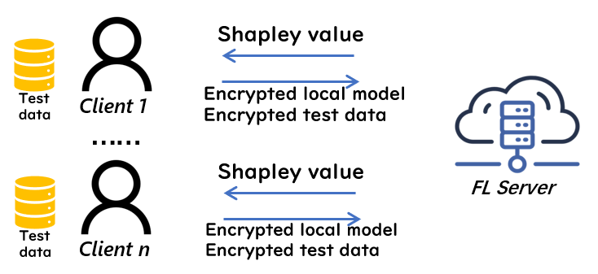
Secure Shapley value
Our proposal: secure SV calculation for secure contribution evaluation
Follows [TIFS18] to train models using FL + HE.
More challenging than [TIFS18]: test data should be protected additionally.
[TIFS18] Phong et al. "Privacy-preserving deep learning via additively homomorphic encryption." TIFS, 13(5):1333-1345, 2018.

